Slide 1

Intensity Transformations and Spatial Filtering
Digital Image processing
3.1 – 3.3
HyunSuk Jang
DGU_Vision_Seminar |rayjang111@dongguk.edu
1

Slide 2
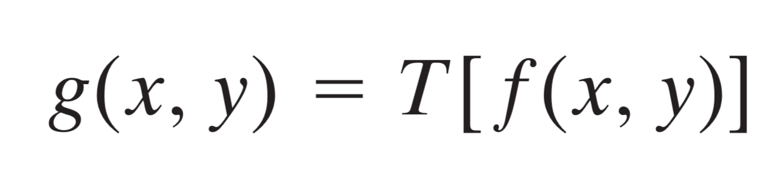
3.1 Background
All image processing techniques in this chapter are implemented in Spatial Domain
Spatial Domain is simply the plane containing the pixels of an image.
Spatial Domain processes we discuss in this chapter can be denoted by the expression
f(x,y) is the input image g(x,y) is the output image, and T is an operator on f defined over a neighborhood of point(x,y)
DGU_Vision_Seminar | rayjang111@dongguk.edu
2

Slide 3
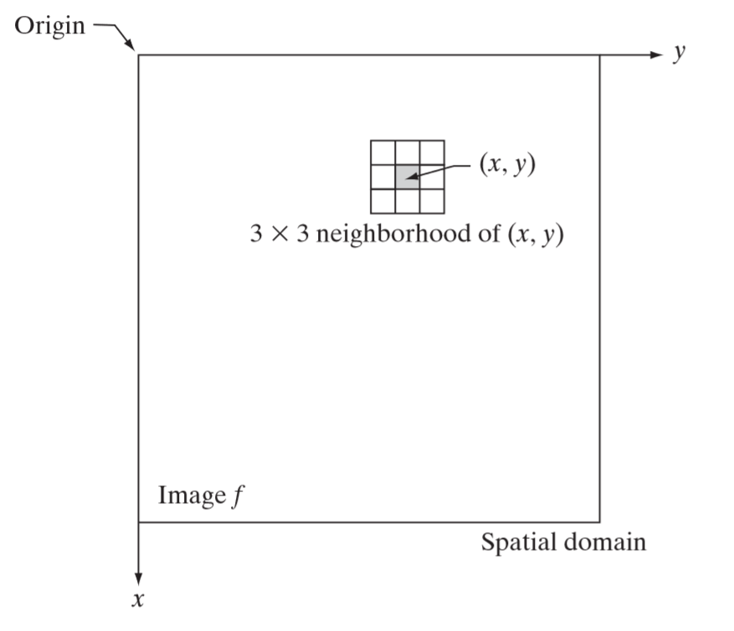
3.1 Background
This Figure illustrates moving the origin of the neighborhood from pixel to pixel and applying the operator T to the pixels in neighborhood
The procedure is called Spatial Filtering and the operation T is called Spatial Filter
DGU_Vision_Seminar | rayjang111@dongguk.edu
3

Slide 4
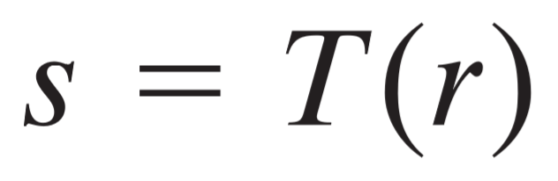
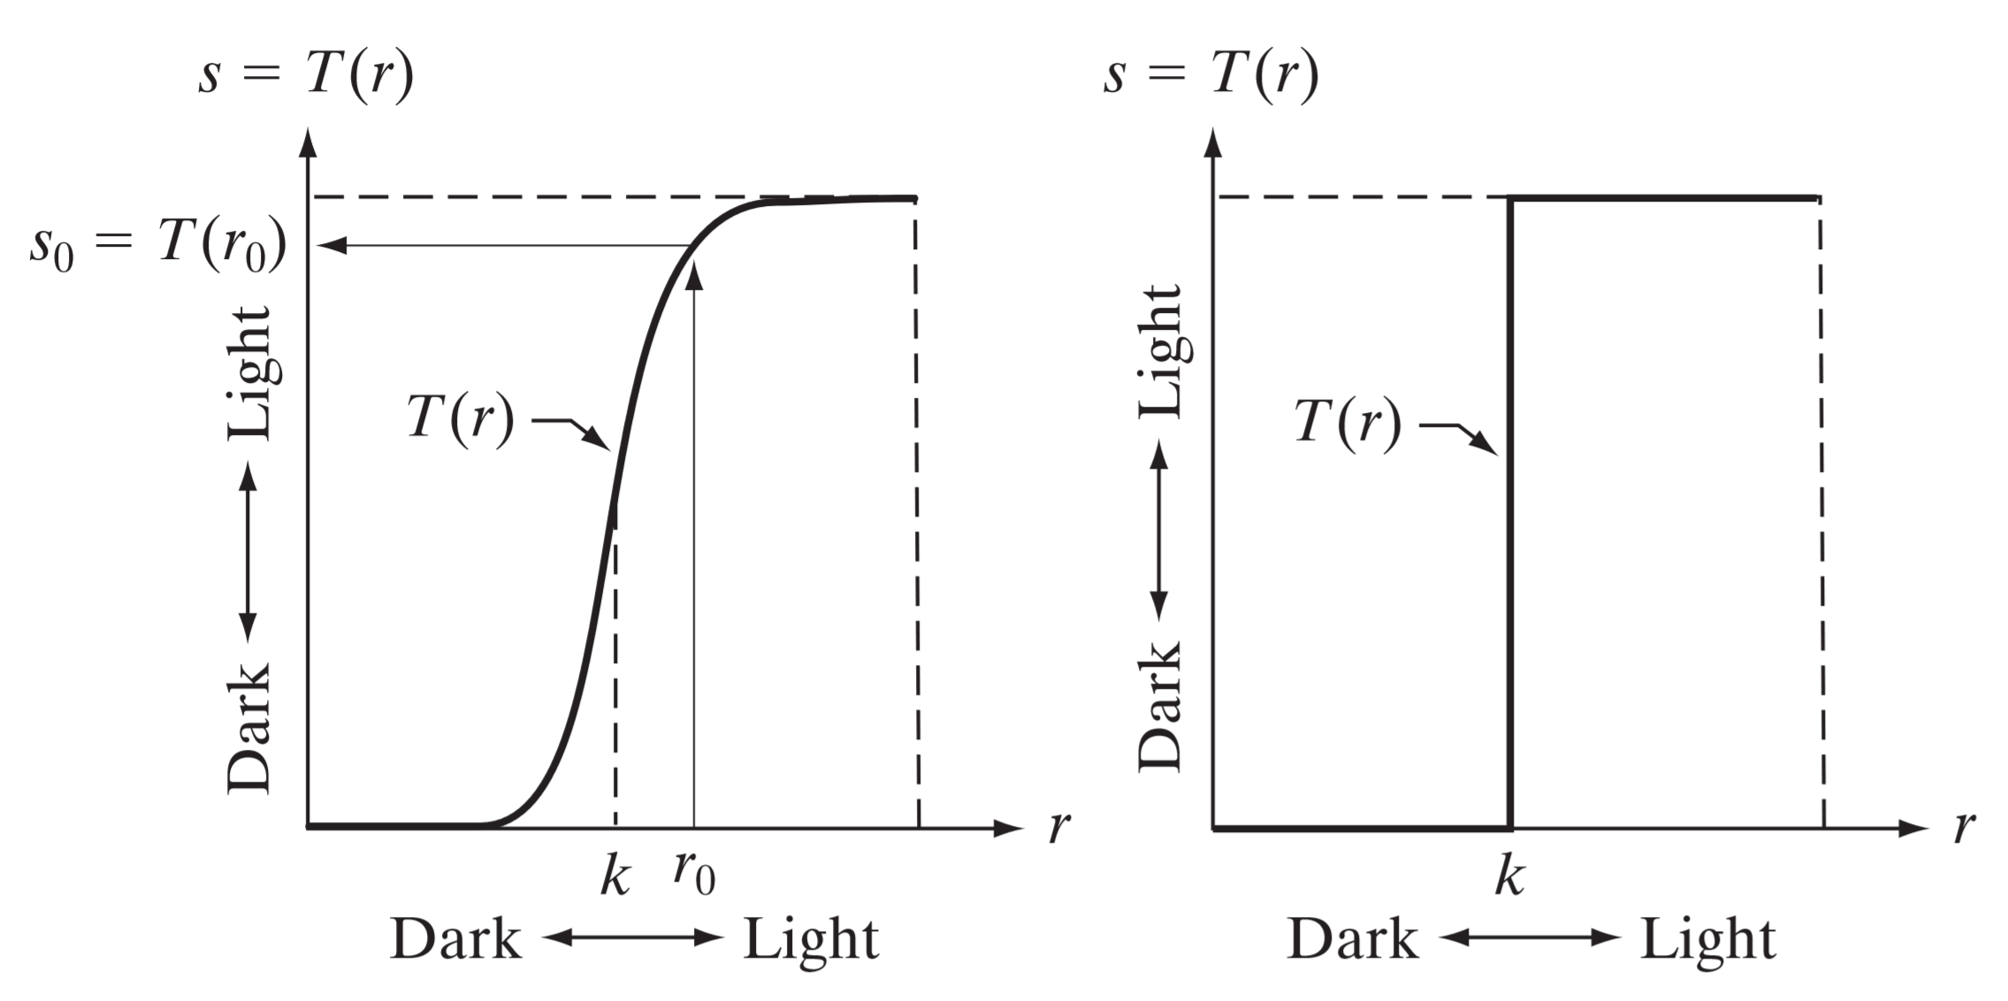
3.1 Background
The smallest possible neighborhood is of size 1x1.
s and r are variables denoting the intensity of g and f at any point(x,y)
Point processing techniques
Contrast-stretching function
Thresholding function
DGU_Vision_Seminar | rayjang111@dongguk.edu
4

Slide 5
3.2 Some basic Intensity transformation Functions
The transformation function used in this section can be denoted as
Because we are dealing with digital quantities, values of a transformation function typically are stored in a one-dimensional array.
This section introduces three basic functions used frequently: linear , logarithmic, power-law
0 | 1 | 2 | 3 | 4
0 | 0 | 1 | 2 | 4
r
s
T
s=T(r)=1/4 r^2
DGU_Vision_Seminar | rayjang111@dongguk.edu
5

Slide 6
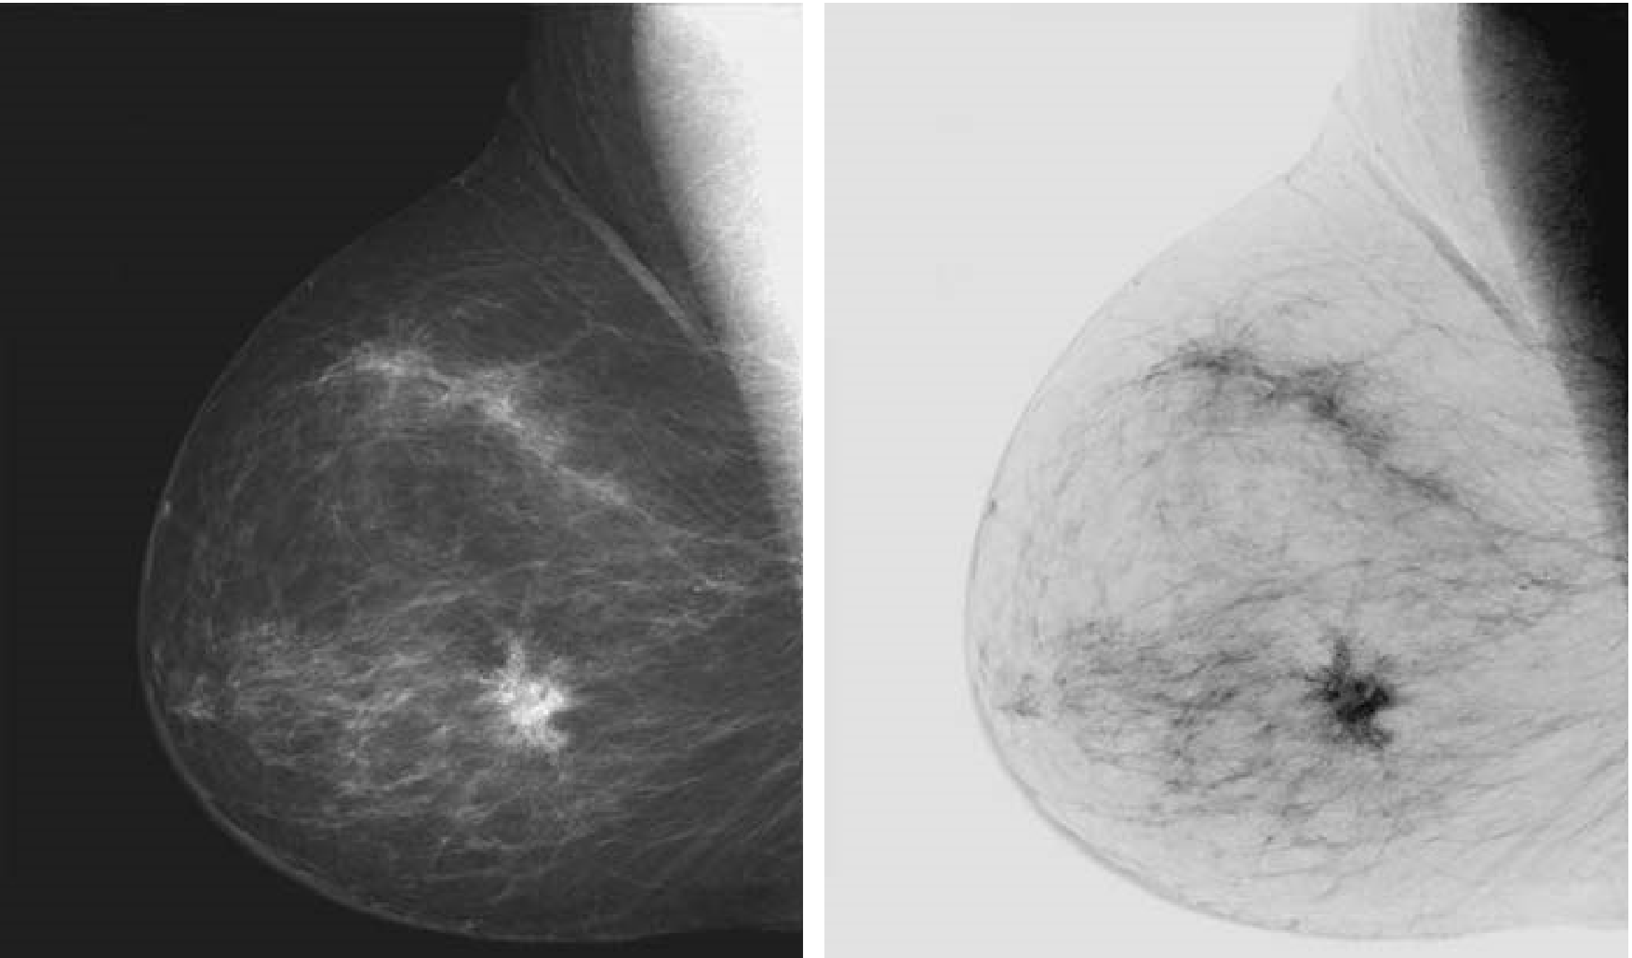

3.2 Some basic Intensity transformation Functions
Image Negatives
The negative of an image in the range [0,L-1] is obtained by using the Negative transformation
Negative transformation is given by the expression
This type of processing is particularly suited for enhancing white or gray detail embedded in dark region
Original image
Negative image
DGU_Vision_Seminar | rayjang111@dongguk.edu
6

Slide 7
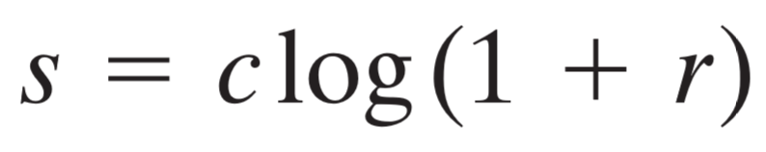
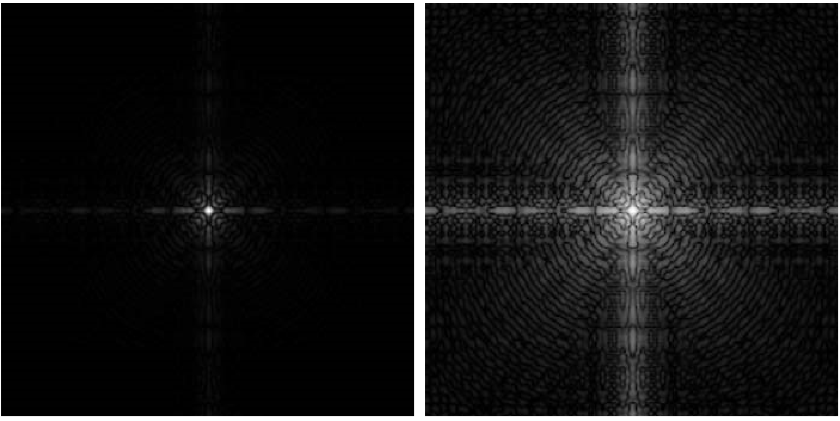
3.2 Some basic Intensity transformation Functions
Log transformation
The general form of the log transformation is
This transformation maps a narrow range of low intensity values into a wider range of output levels
Higher values of input is compressed to narrow range of input levels
The opposite is true of the inverse log transformations
Original image
(Fourier Spectrum)
Log transformed image
DGU_Vision_Seminar | rayjang111@dongguk.edu
7

Slide 8
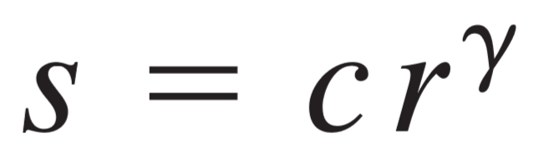
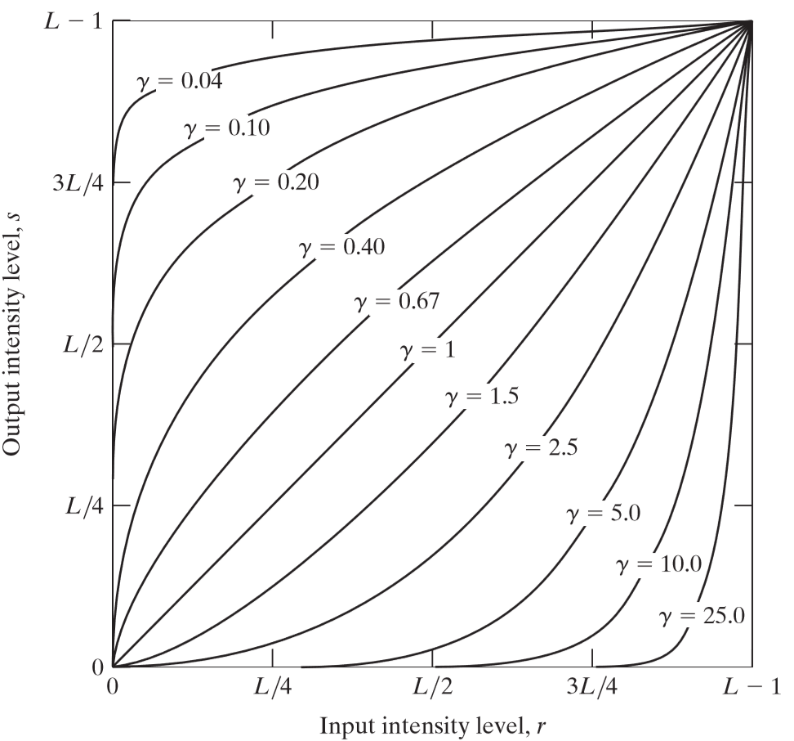

3.2 Some basic Intensity transformation Functions
Power-Law (Gamma) Transformations
The Power-Law transformation have the basic form
Power-Law curves with fractional values of maps a narrow range of low intensity values into a wider range of output levels
The opposite is true to >1
Compared to Log transformations, Power-Law transformation is more versatile for this purpose
DGU_Vision_Seminar | rayjang111@dongguk.edu
8

Slide 9
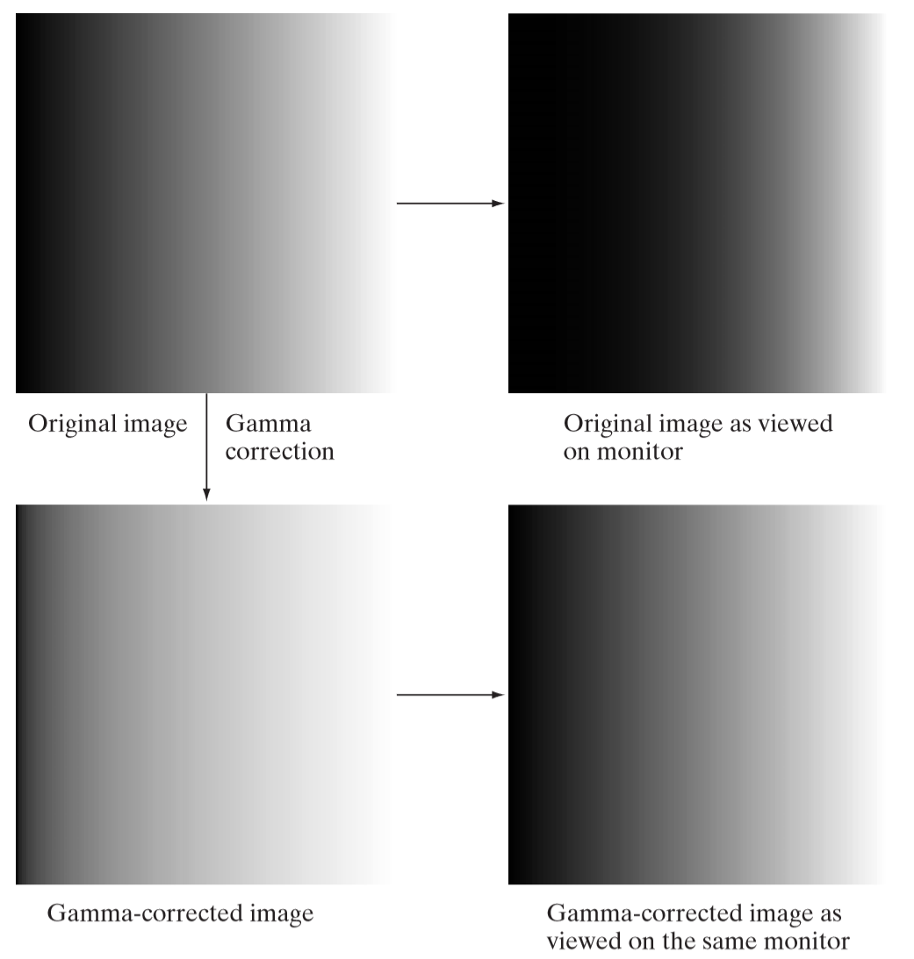
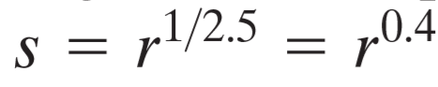
3.2 Some basic Intensity transformation Functions
Gamma Correction
Variety of devices used for image capture, printing, and display respond according to a Power-Law(gamma)
The process used to correct these power law response phenomena is called gamma correction
This picture gives an example of a monitor with a gamma of 2.5
The monitor produces images darker than intended
By performing gamma correction
we can see close appearance to original image
DGU_Vision_Seminar | rayjang111@dongguk.edu
9

Slide 10
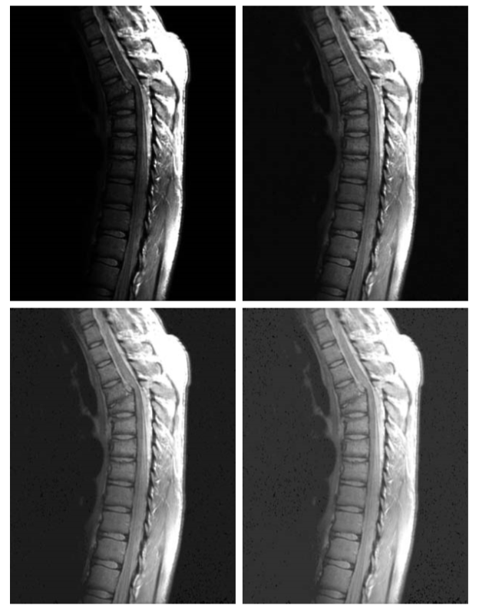
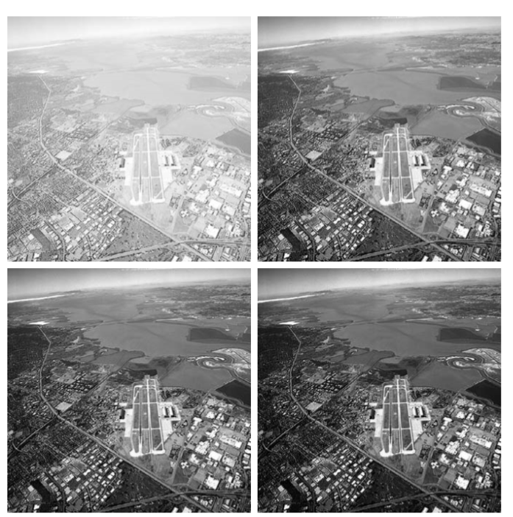
3.2 Some basic Intensity transformation Functions
In addition to gamma correction, Power-Law transformation are useful for general-purpose contrast manipulation
Gamma<1
(0.6,0.4,0.3)
Gamma>1
(3.0,4.0,5.0)
DGU_Vision_Seminar | rayjang111@dongguk.edu
10

Slide 11
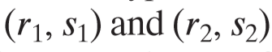
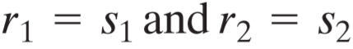
3.2 Some basic Intensity transformation Functions
Piecewise-Linear Transformation Functions
Advantage- can be arbitrary complex
Disadvantage- requires more user input
Contrast stretching
Process that expands the range of intensity levels in an image.
The locations of points control the shape of the transformation
If then the transformation produces no change
If the transformation becomes a thresholding function
DGU_Vision_Seminar | rayjang111@dongguk.edu
11

Slide 12
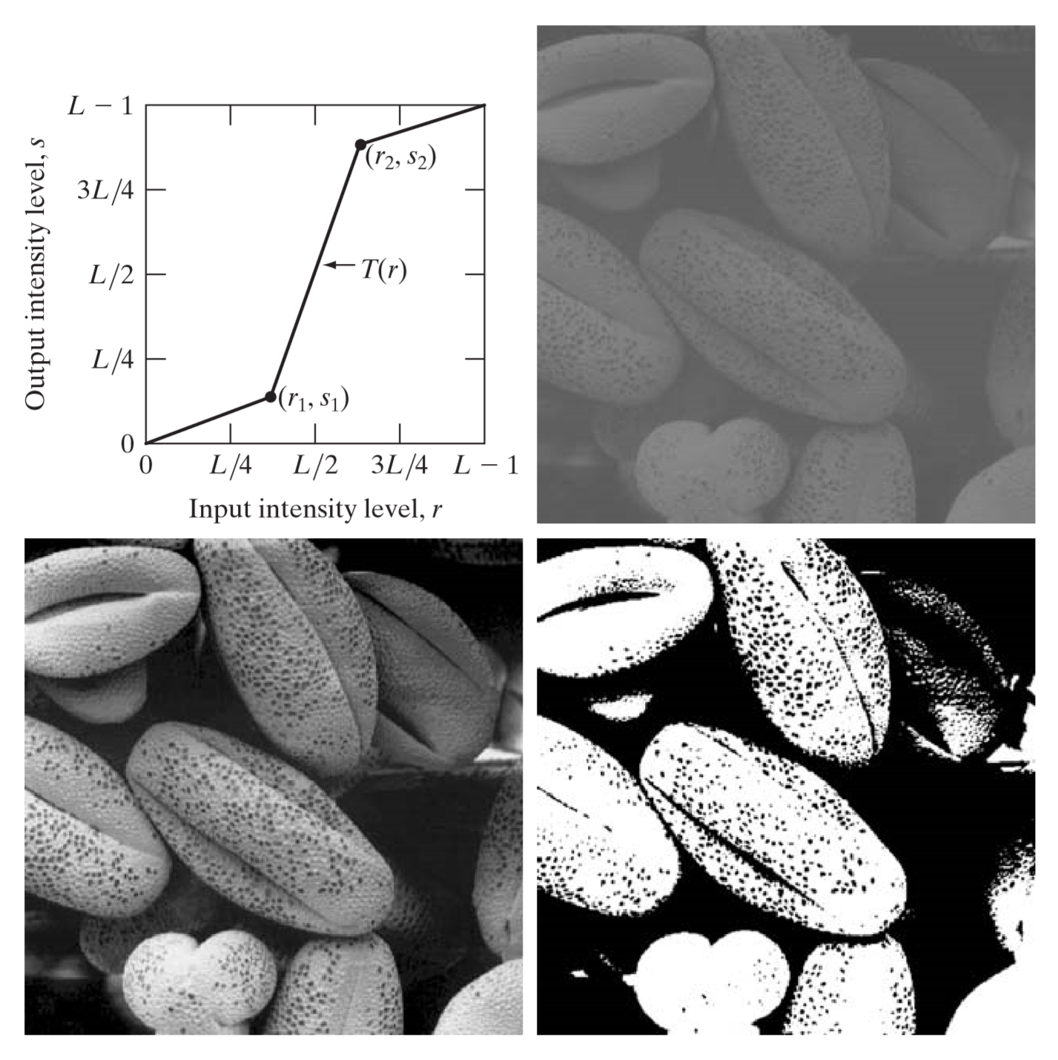

3.2 Some basic Intensity transformation Functions
Contrast Stretching
(b) original image
(c)image transformed
by (a)
(d) Binary image
DGU_Vision_Seminar | rayjang111@dongguk.edu
12

Slide 13
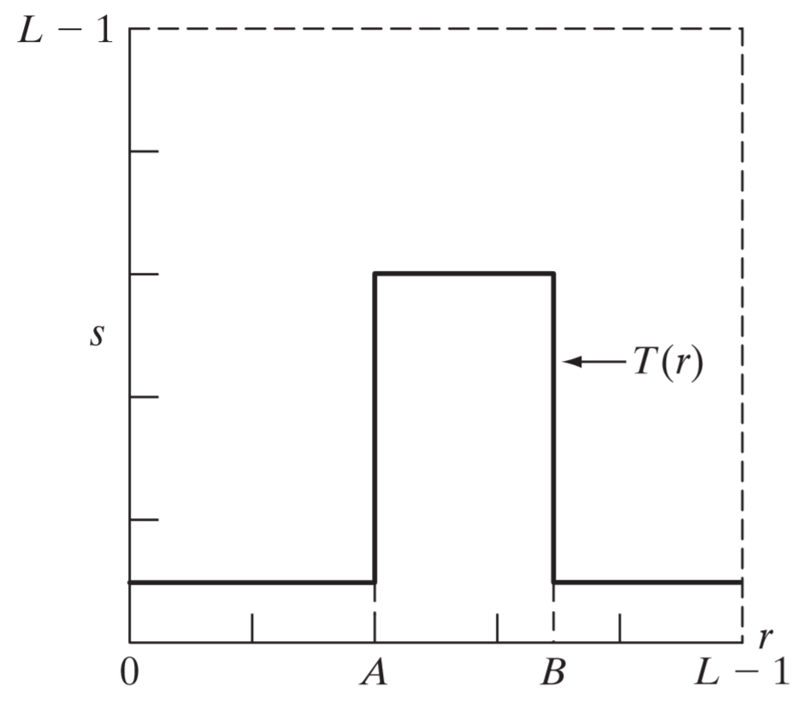
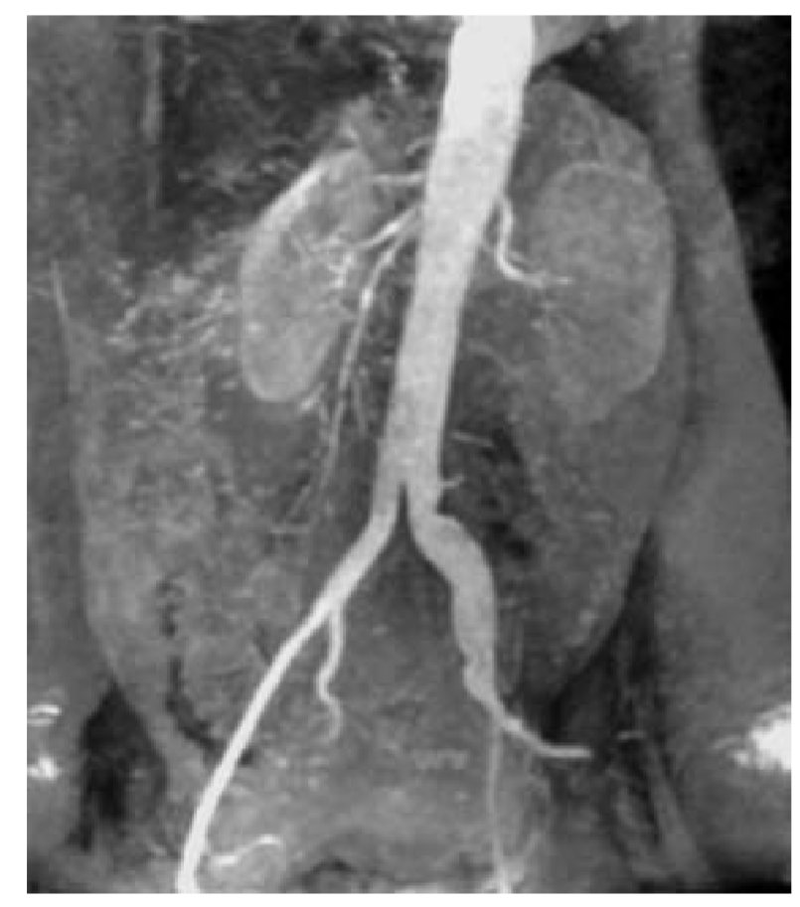
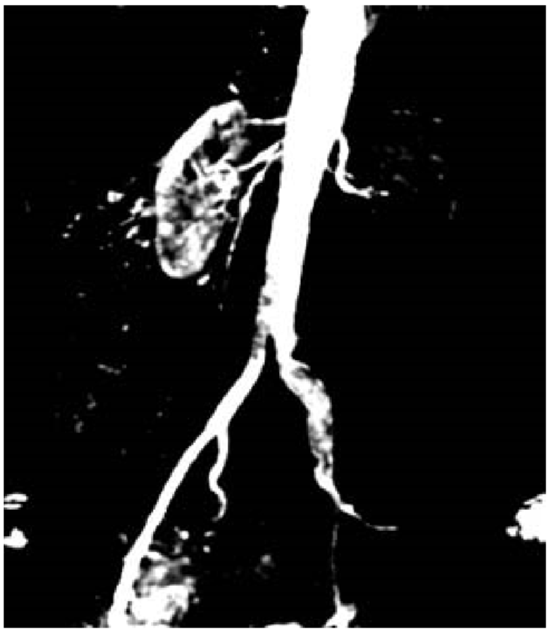
3.2 Some basic Intensity transformation Functions
Intensity level slicing
Can be implemented in several ways but most are variations of two basic themes.
One approach is to display all the values in the range of interest in one value and other intensities to other value.
DGU_Vision_Seminar | rayjang111@dongguk.edu
13

Slide 14
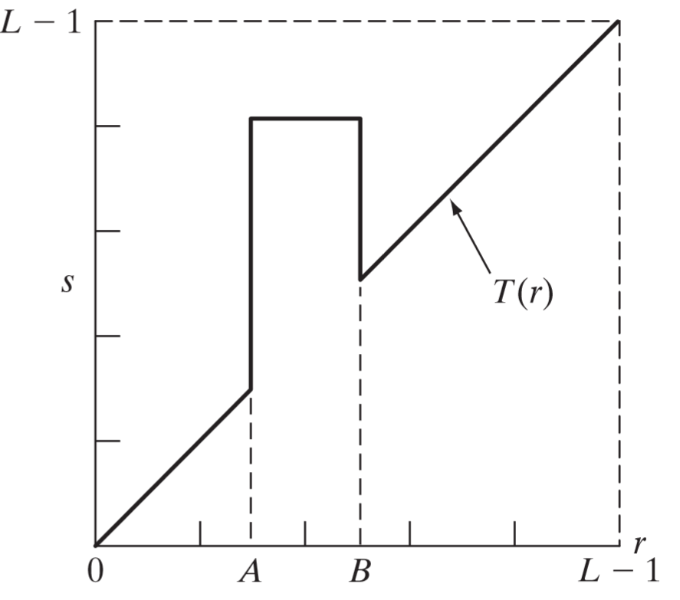
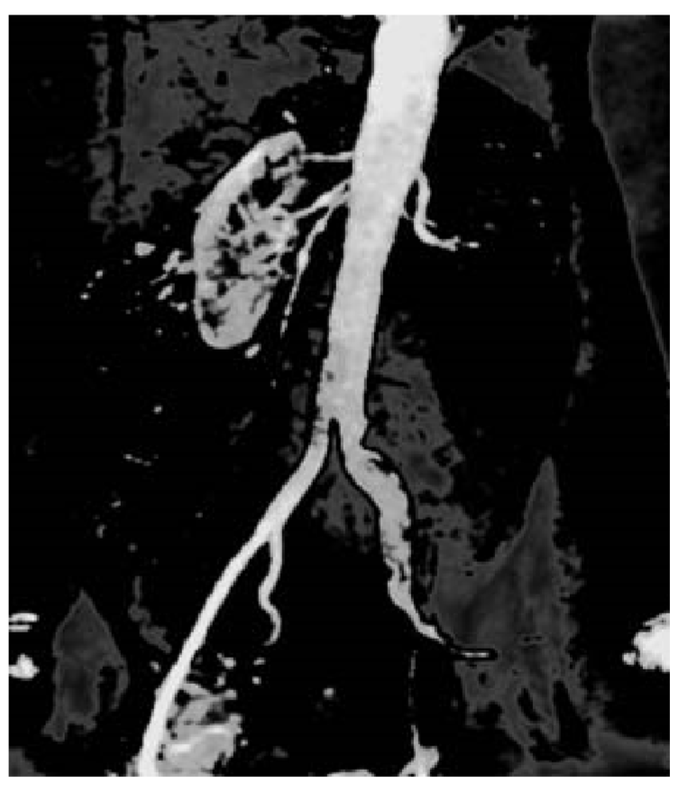
3.2 Some basic Intensity transformation Functions
Intensity level slicing
The second approach brightens the desired range of intensities of but leaves other intensity levels in the image unchanged
In this case it actually lowered the desired range of intensities
DGU_Vision_Seminar | rayjang111@dongguk.edu
14

Slide 15
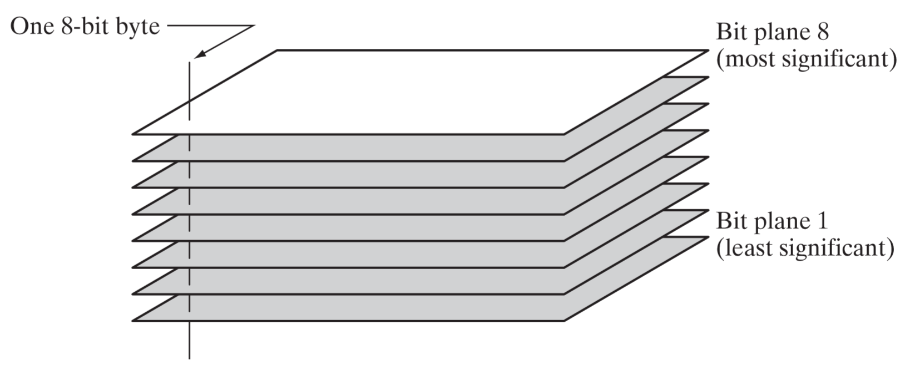
3.2 Some basic Intensity transformation Functions
Bit-plane slicing
An 8-bit image may be considered as a being composed of eight 1-bit planes
Each plane gets binary image. For example, 8th bit plane maps all intensities between 0-127 to 0 and 128-255 to 1
DGU_Vision_Seminar | rayjang111@dongguk.edu
15

Slide 16
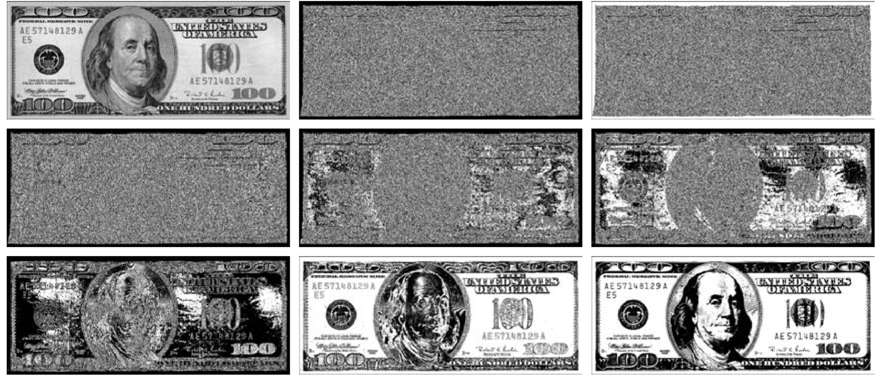

3.2 Some basic Intensity transformation Functions
Bit-plane slicing
(a) is original image
(b) through (i) corresponds to bit planes1 through 8
DGU_Vision_Seminar | rayjang111@dongguk.edu
16

Slide 17
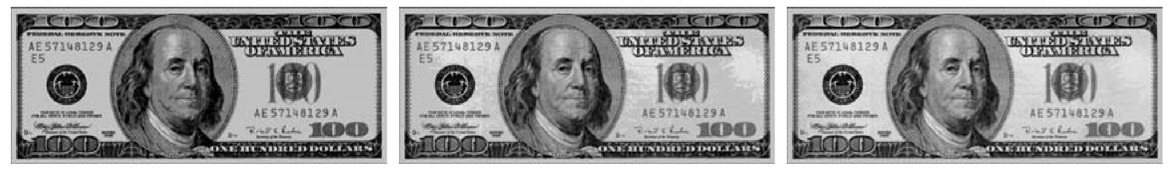
3.2 Some basic Intensity transformation Functions
Bit-plane slicing
Decomposing an image into its bit planes is useful for analyzing the relative importance in the image.
This type of decomposition is useful for image compression
Using 4 bit planes uses 50% storage of original image and 2 bit planes uses 25% of storage
Image reconstructed using high bit planes
8,7=>8,7,6=>8,7,6,5
DGU_Vision_Seminar | rayjang111@dongguk.edu
17

Slide 18
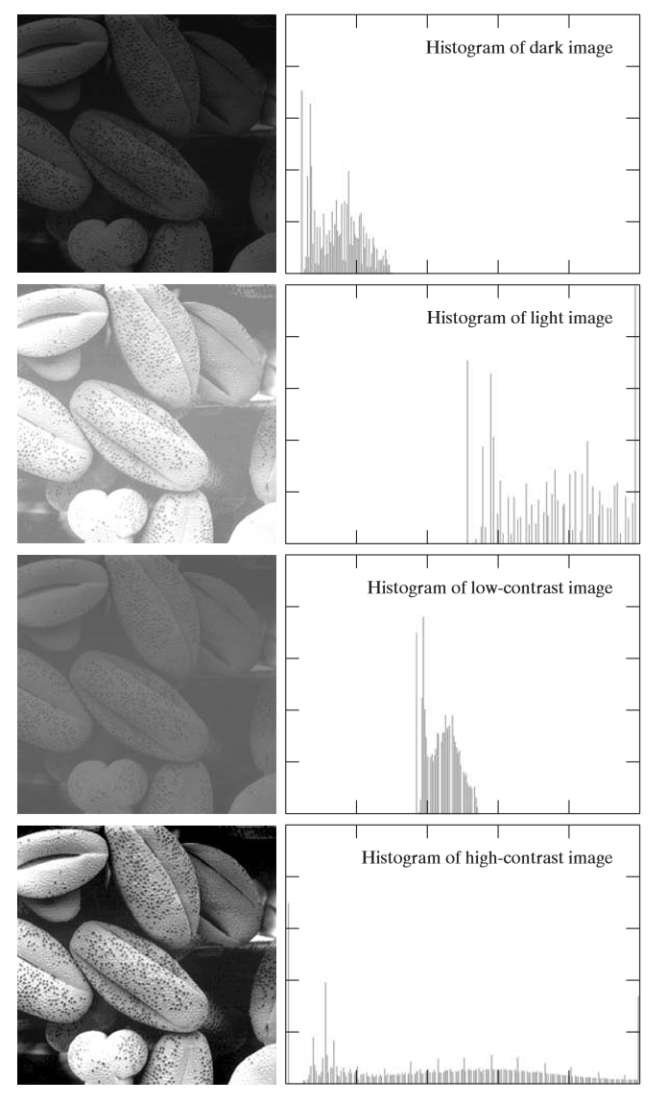
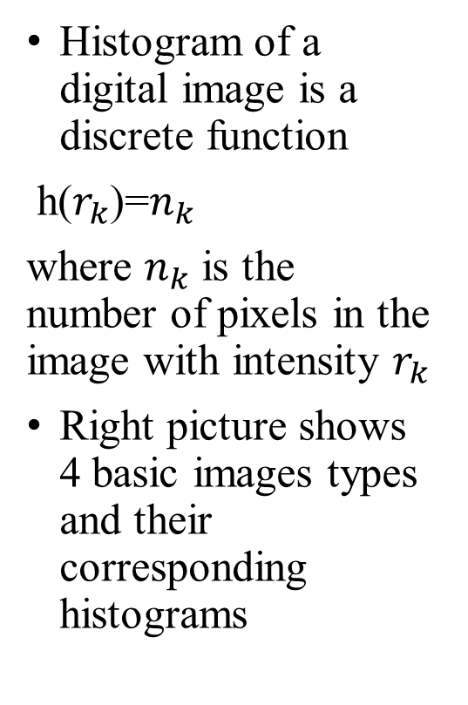
3.3 Histogram Processing
Histogram of a digital image is a discrete function
h($r_{k}$)=$n_{k}$
where $n_{k}$ is the number of pixels in the image with intensity $r_{k}$
Right picture shows 4 basic images types and their corresponding histograms
DGU_Vision_Seminar | rayjang111@dongguk.edu
18

Slide 19
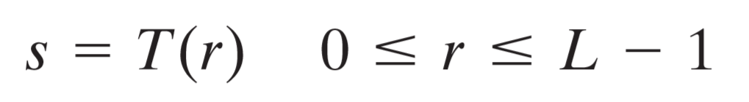
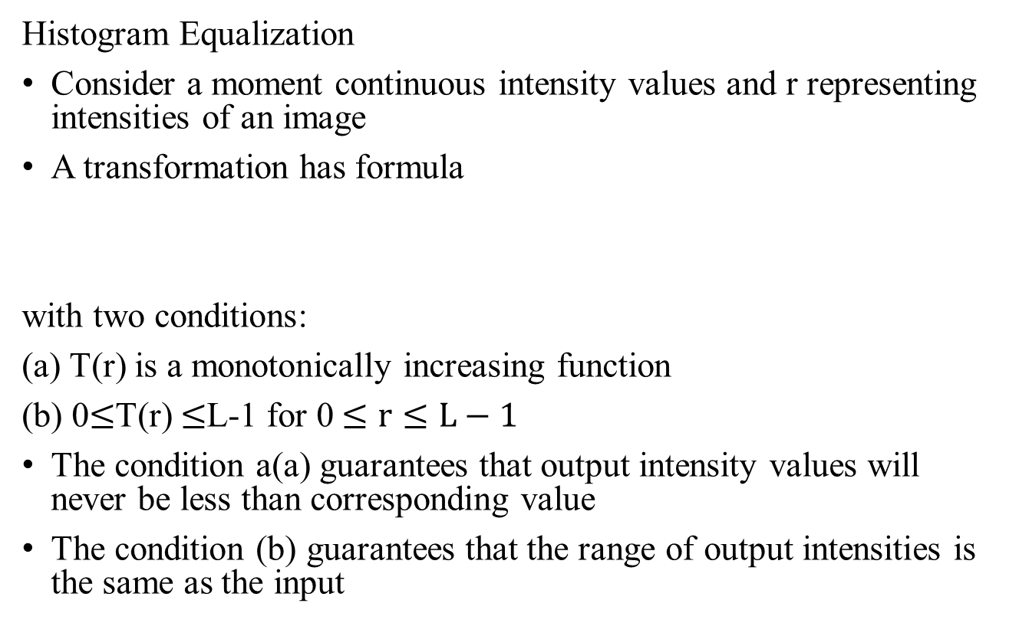
3.3 Histogram Processing
Histogram Equalization
Consider a moment continuous intensity values and r representing intensities of an image
A transformation has formula
with two conditions:
(a) T(r) is a monotonically increasing function
(b) 0$≤$T(r) $≤$L-1 for 0 $≤r≤L−1$
The condition a(a) guarantees that output intensity values will never be less than corresponding value
The condition (b) guarantees that the range of output intensities is the same as the input
DGU_Vision_Seminar | rayjang111@dongguk.edu
19

Slide 20
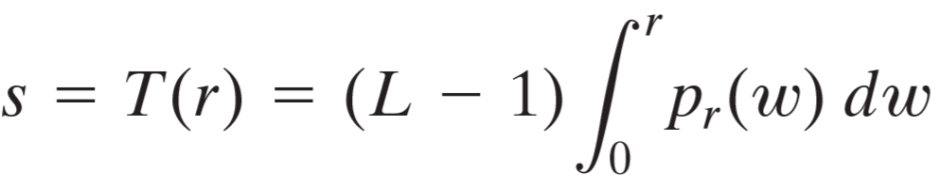
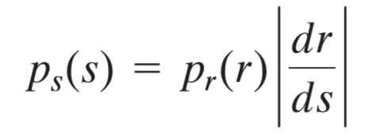
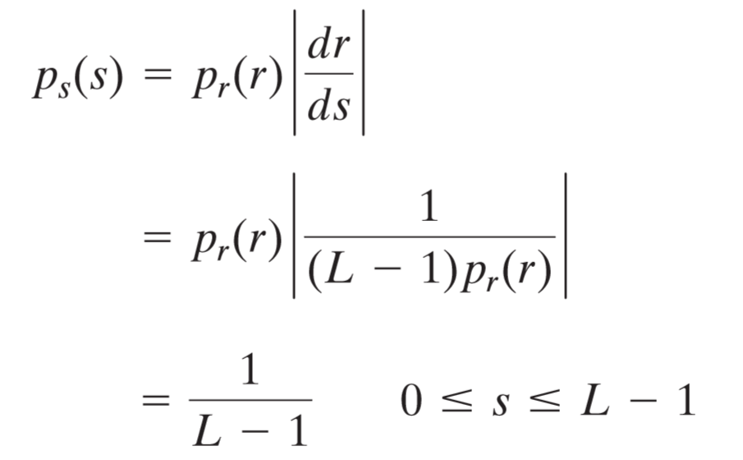
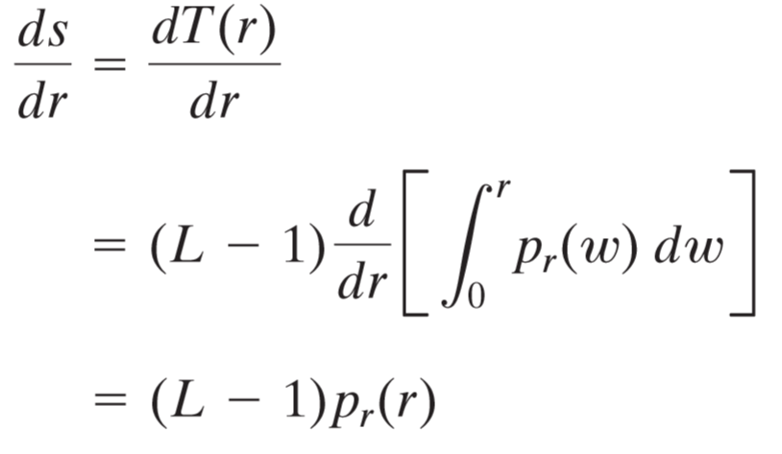
3.3 Histogram Processing
Histogram Equalization
A transformation function of particular importance in image has the form
the right side is also recognized as CDF
DGU_Vision_Seminar | rayjang111@dongguk.edu
20

Slide 21
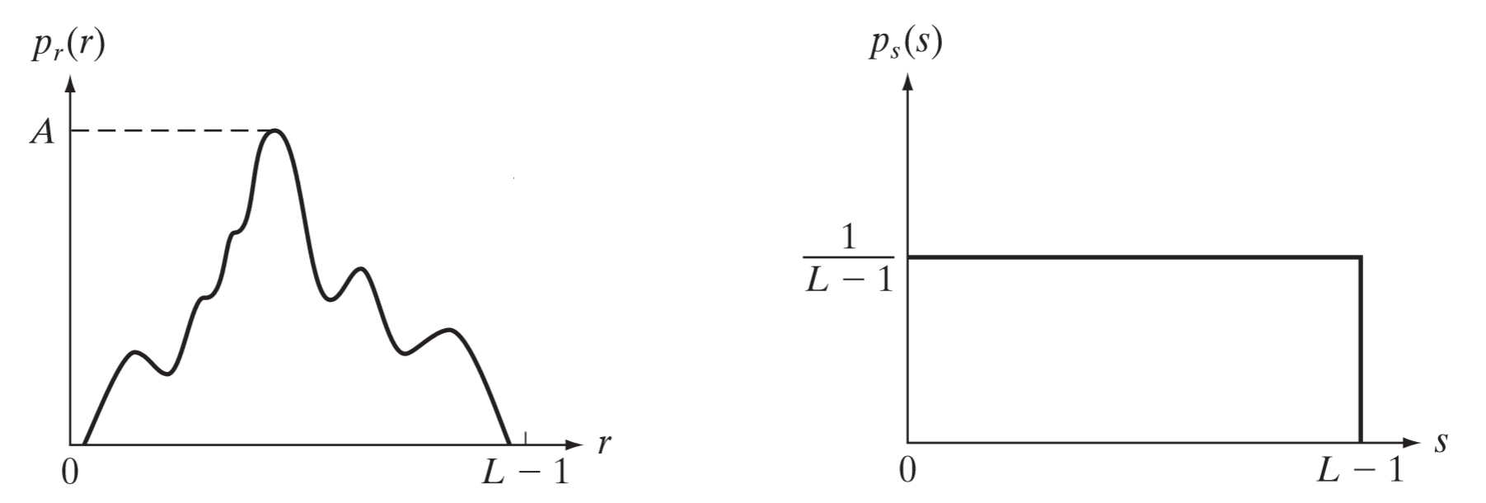
3.3 Histogram Processing
Hist of original image
Hist of equalized image
DGU_Vision_Seminar | rayjang111@dongguk.edu
21

Slide 22
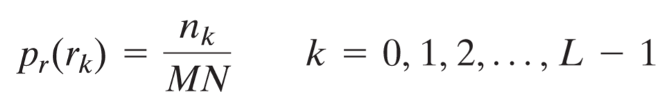
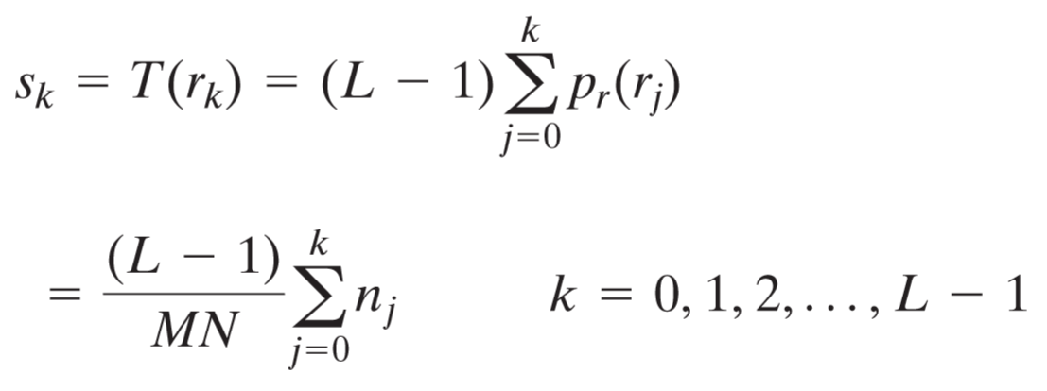
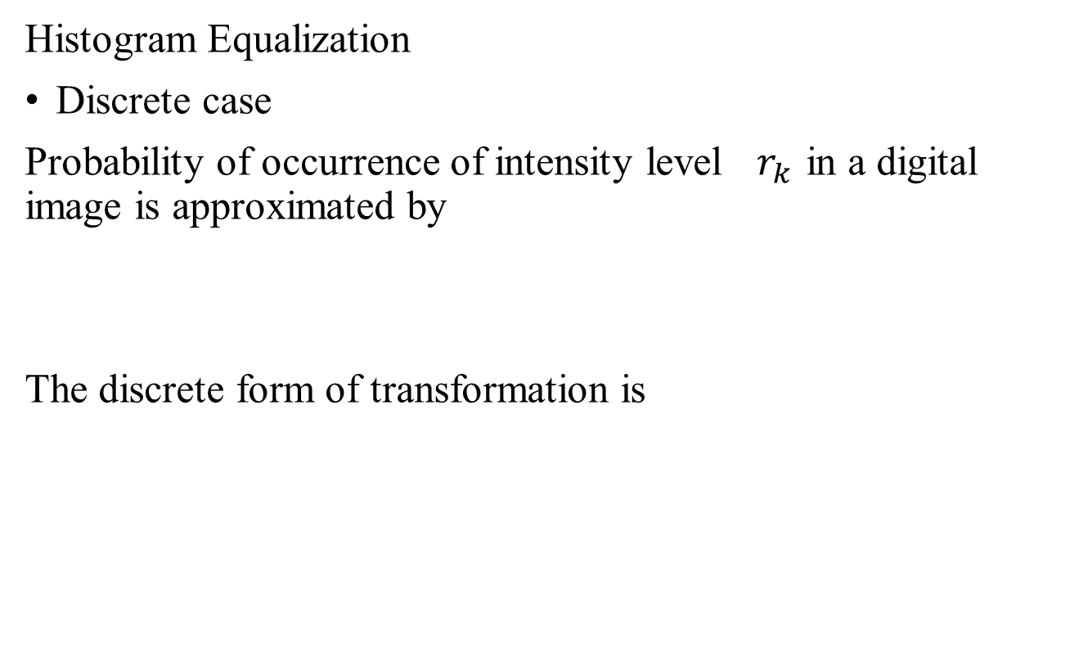
3.3 Histogram Processing
Histogram Equalization
Discrete case
Probability of occurrence of intensity level$r_{k}$ in a digital image is approximated by
The discrete form of transformation is
DGU_Vision_Seminar | rayjang111@dongguk.edu
22

Slide 23
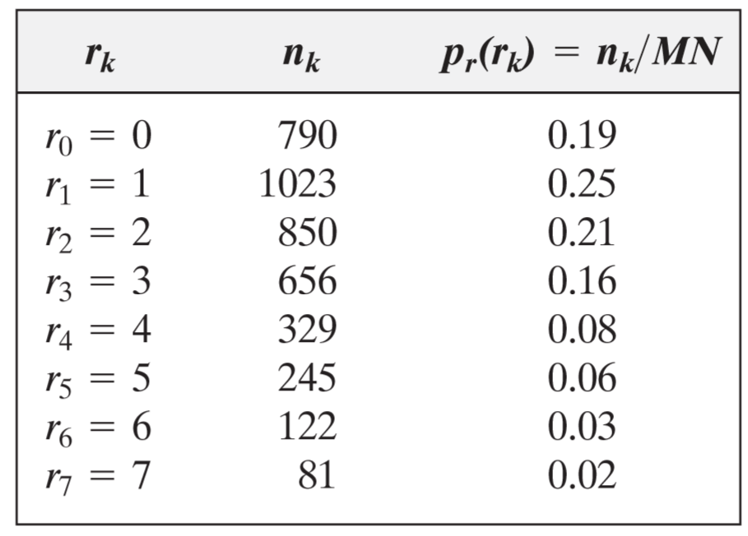
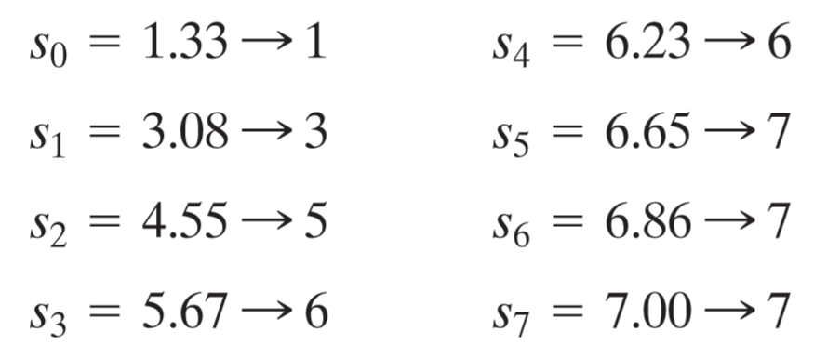
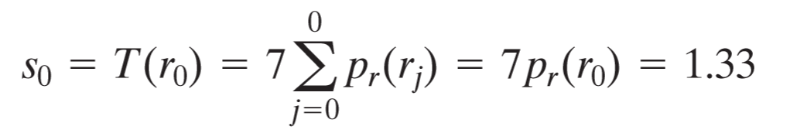
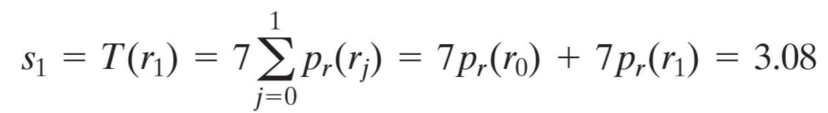
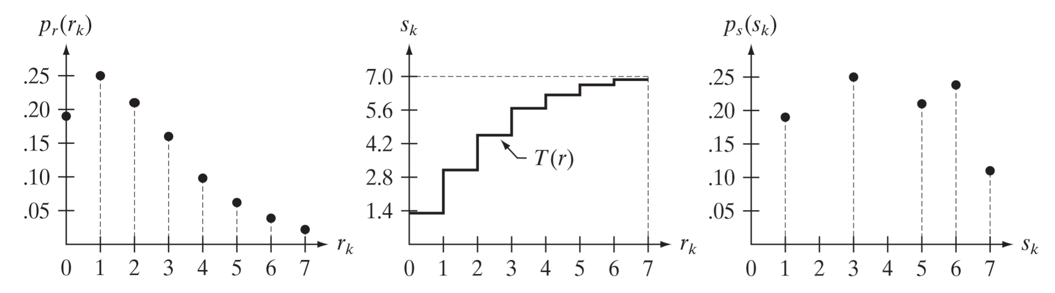
3.3 Histogram Processing
3 bit case example
DGU_Vision_Seminar | rayjang111@dongguk.edu
23

Slide 24
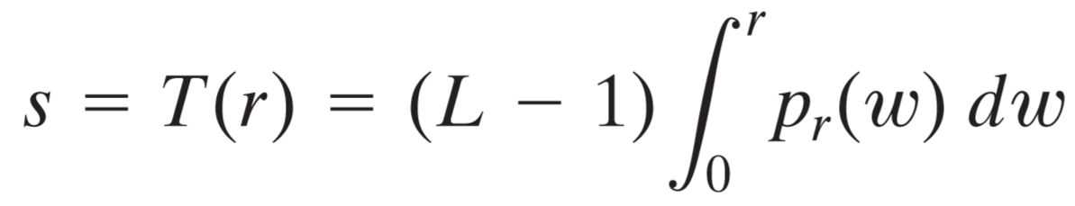
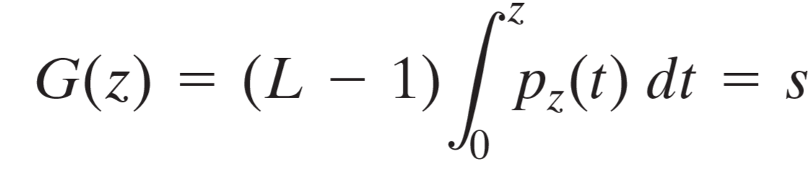
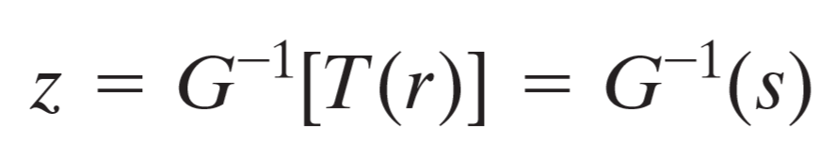
3.3 Histogram Processing
Histogram Matching (Specification)
Sometimes it is useful to be able to specify the shape of the histogram that we wish the processed image to have
Formula:
Let G(z)=T(r) then,
DGU_Vision_Seminar | rayjang111@dongguk.edu
24

Slide 25
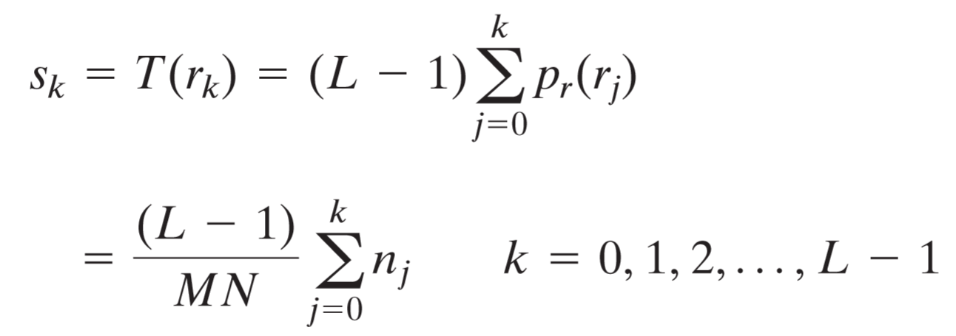
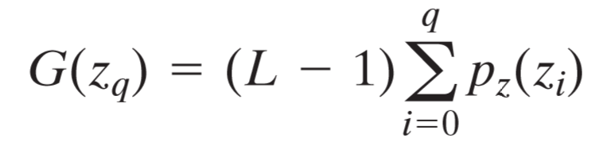
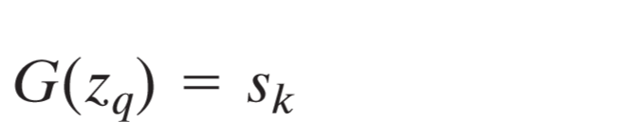
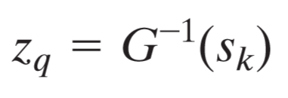
3.3 Histogram Processing
Histogram Matching (Specification)
Discrete case
Let
Then,
DGU_Vision_Seminar | rayjang111@dongguk.edu
25

Slide 26
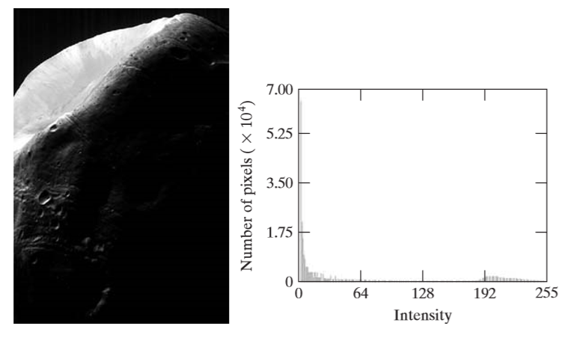
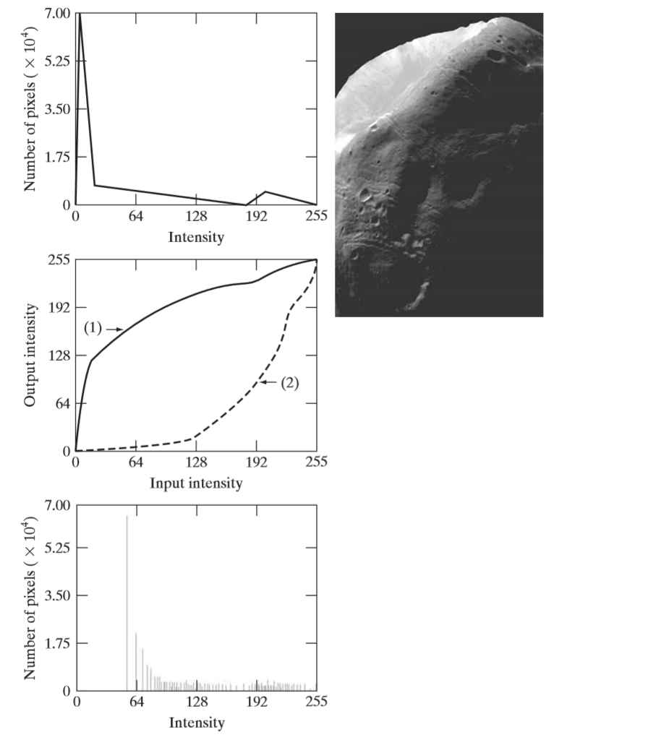

3.3 Histogram Processing
Equalization
Specification
DGU_Vision_Seminar | rayjang111@dongguk.edu
26

Slide 27

3. Histogram Processing
Local Histogram Processing
There are cases in which it is necessary to enhance details over small areas in an image
Original image
Global histogram equalization
Local histogram equalization using neighborhood 3x3
DGU_Vision_Seminar | rayjang111@dongguk.edu
27

Slide 28




3. Histogram Processing
Using Histogram Statistics for Image Enhancement
Mean
Variance
Local mean, variance can be computed the same way using neighborhood intensities
DGU_Vision_Seminar | rayjang111@dongguk.edu
28

Slide 29
Thank you
DGU_Vision_Seminar | jjy1000@dongguk.edu

